Slide 1
Course Title: numbers of students :
Learning objectives :
….
…

Slide 2

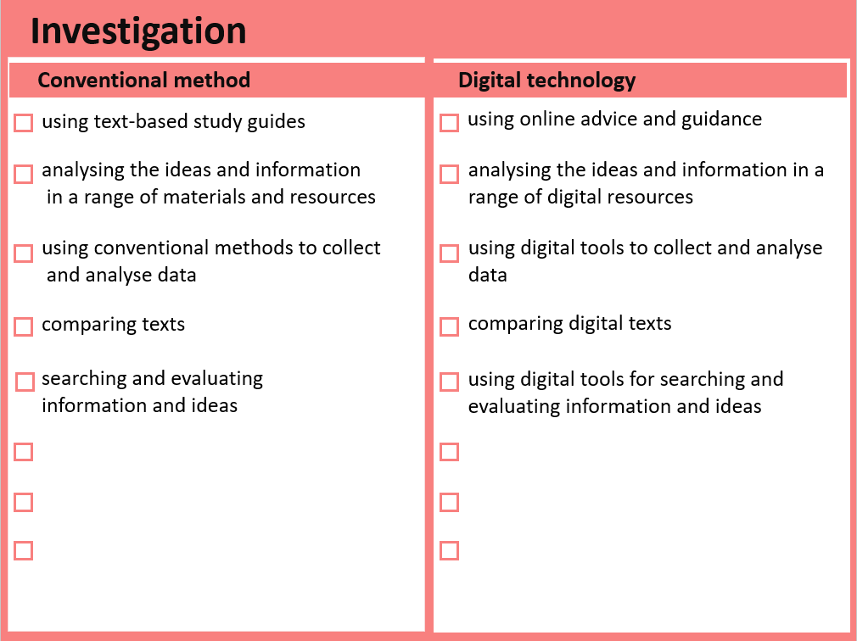
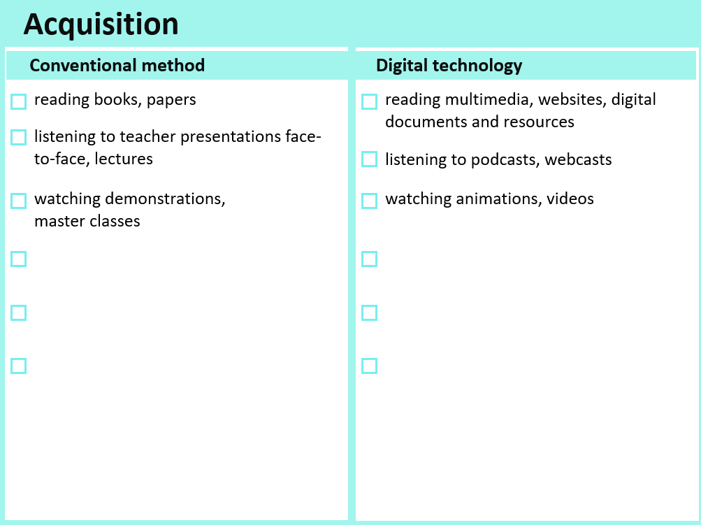
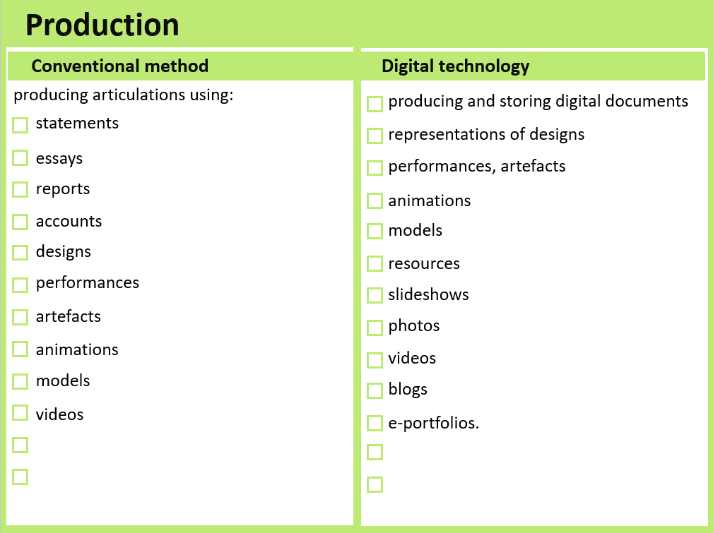

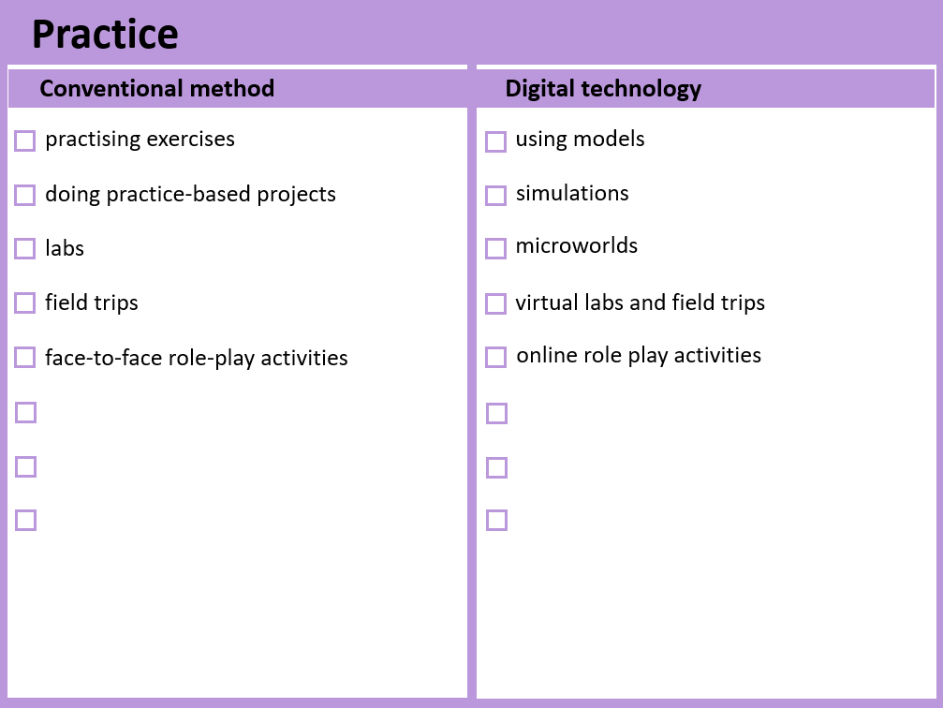

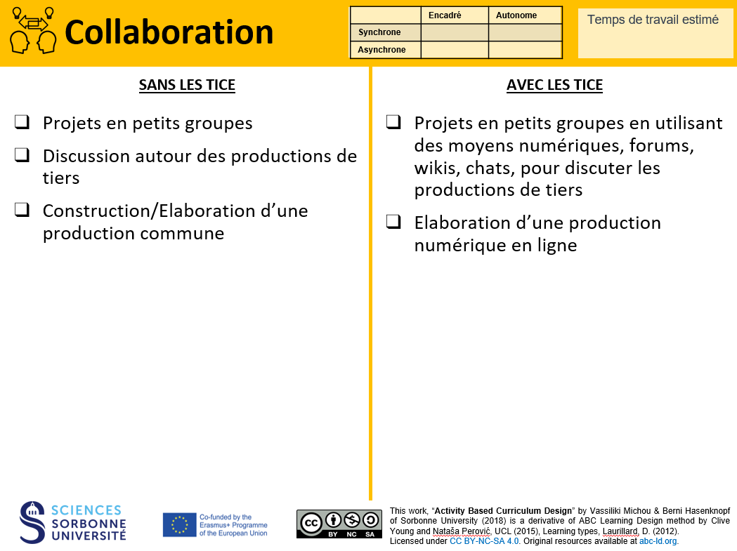
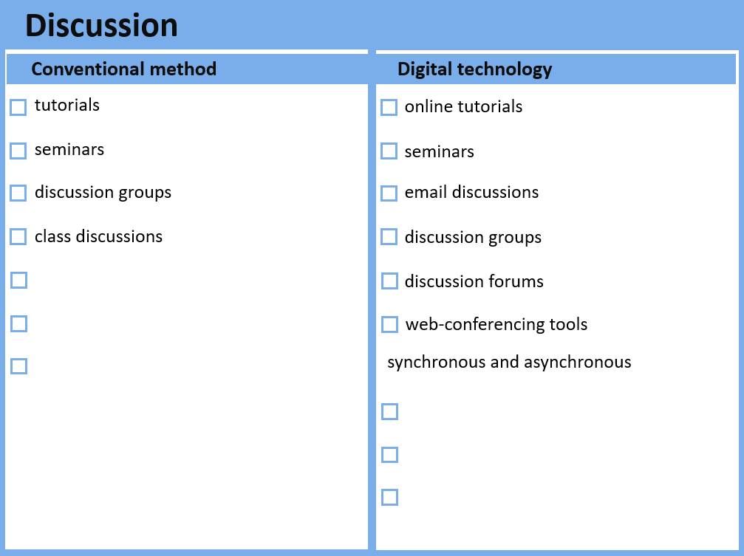



Choose one or more cards AND indicate the time for each activity
 | Individuel | Groupe
Présence
Distance
Before The session
Your suggestion :
Your suggestion :
Your suggestion :
Your suggestion :
Your suggestion :
Your suggestion :

Slide 3
Choose one or more cards AND indicate the time for each activity
 | Individuel | Groupe
Présence
Distance
During The session
Your suggestion :
Your suggestion :
Your suggestion :
Your suggestion :
Your suggestion :
Your suggestion :

Slide 4
Choose one or more cards AND indicate the time for each activity
 | Individuel | Groupe
Présence
Distance
After The session
Your suggestion :
Your suggestion :
Your suggestion :
Your suggestion :
Your suggestion :
Your suggestion :

